Slide 1
Innovation ofTraffic Management System
INTRODUCTION
One of the major problems faced in any metro city is traffic congestion.
Heavy traffic is a headache for each and every person driving the vechicles
and even to the traffic police in controlling the traffic.
Traffic congections has a negative impact on economy, the environment and the overall quality of life.
There are two ways through which traffic is been controlled
1)Manually
2)Systematically(controllers).
However the whole idea of a fixed time traffic light controller is not convenient for cities where traffic flow is variable.
For this reason a dynamic traffic control system is need, which controls the traffic signals according to the density of traffic.
In our project we focus on optimization of traffic light using IR sensor & Arduino UNO as a microcontroller.
In our project our approach is to take data/input from IR sensor it will allows us to detect whether the road is congested or not & will allows us to manage our traffic according to our input.

Slide 2
WORKING
This project works on the principle that when a car passes between the IR transmitter & IR receiver , the IR light is blocked and as the result the resistance of the photodiode increases, this change in resistance is converted to electrical pulse, which is used to control traffic lights.
COMPONENTS USED
Arduino UNO
IR sensors(IR transmitter & receiver)
LED’S(12)
Resistors(1k ohm)
Power supply(5v)
Jumping wires

Slide 3
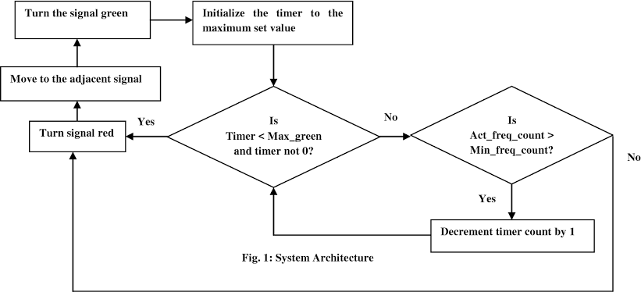
BLOCK DIAGRAM

Slide 4
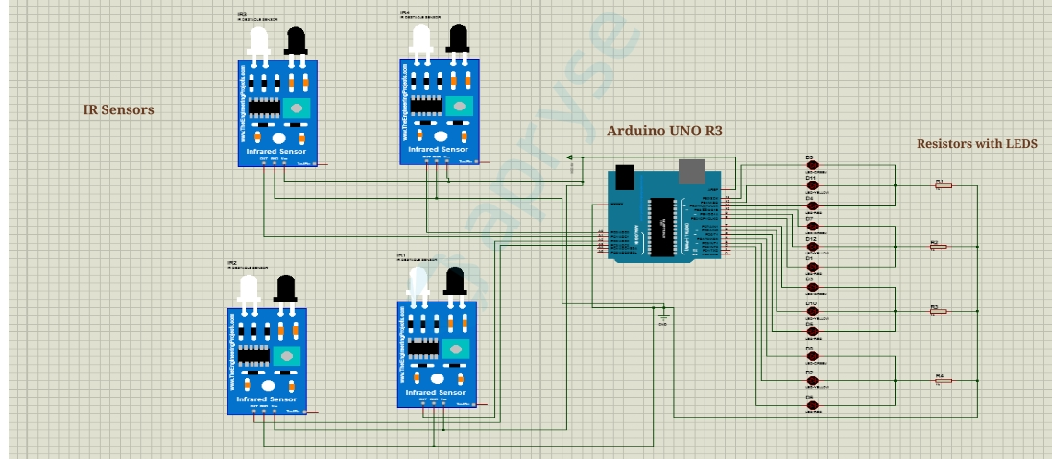
CIRCUIT DIAGRAM

Slide 5
Benefits
Traffic management technology can benefit all commuters – from drivers to cyclists to public transit users – by creating roadways that are safer, smarter, and more efficient.
These benefits extend beyond the road and have been proven to have positive impacts extending from the economy to the environment.
Let’s take a look at some of the major benefits of intelligent traffic management technologies.
Traffic Reduction And Time Saved
The average American commuter is projected by 2025 to spend 62 hours a year stuck in low-flow traffic.
That’s more than two and a half days worth of time wasted.
However, researchers found that U.S. cities implementing Intelligent Transportation System (ITS) technologies improved traffic flow and saved commuters 175 million hours a year in travel time.
The expansion of ITS and other traffic safety technologies has the potential to drastically reduce traffic congestion and commute times nationwide.

Slide 6
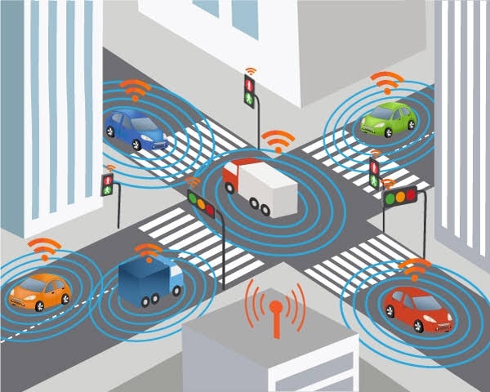
Environmentally Friendly
Traffic management technologies create more efficient systems that reduce both the number of drivers on the road and the time each individual spends driving or struck in traffic.
This is good for commuters and for the earth.
The same ITS technologies – ranging from roadside cameras to 511 information systems to cell phone traffic apps – have also been shown to help drastically reduce pollution.
Cities that used these technologies saw a 53 million gallon decrease in fossil fuel consumption and a 10 billion pound reduction of C02 emissions annually

Slide 7
Safer, More Inclusive Streets
OECD research on infrastructure-based safety systems has tied the technologies to the drastic reductions in the number of fatal car accidents.
Traffic technologies also collect data on street use and driving patterns that influence future infrastructure developments.
This helps planners create street systems that are safer for drivers, pedestrians, and cyclists alike.
Expanding these technologies is crucial to helping reduce the number of bike accidents and pedestrian deaths and for developing street plans that foster diverse modes of transportation.
.
Recent Innovations
Planners and policymakers are embracing new, advanced traffic management systems to reduce congestion and create safer, more successful communities.
These innovative solutions are used alongside traditional methods and give city officials new insights into how to make roadways more efficient and sustainable.
Let’s take a look at a few of these technologies shaping our future.

Slide 8
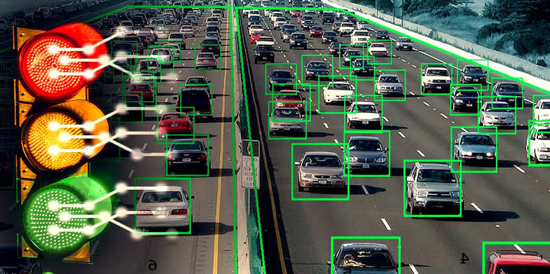
Real-Time Traffic Feedback
Cities across the United States have started utilizing Internet of Things (IoT)-enabled sensors.
These sensors are placed on roads and public transit routes and allow anyone to go online to view levels of traffic congestion, available parking spaces, and locations of busses and streetcars.
The Kansas City streetcar system’s IoT sensors have helped revitalize the public transit system as citizens know exactly where the streetcars are and how long before they reach pickup locations.
Adaptive Traffic Signals
Vehicle to Infrastructure (V2I) technology lets automobiles “communicate” with adaptive traffic control signals to help cities gain better insights into traffic patterns and problems.
Cities are outfitting government vehicles with V2I devices that relay information about individual cars’ speeds, movements, time spent at lights, and other valuable data.
This information is giving officials insight into how long vehicles sit at idle lights, so they can improve signal timing to make drive times more sustainable and efficient.

Slide 9
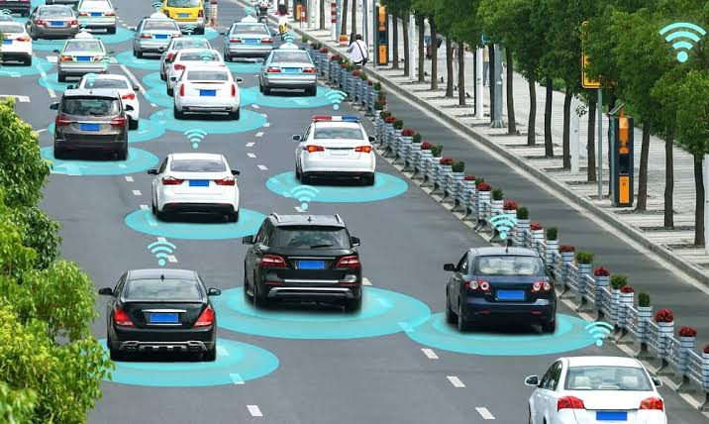
The Future Outlook Of Traffic Management Through Technology
Traffic management technologies are changing how we drive and how we live.
Not only can they help alleviate America’s roadway congestion crisis, but they’re also helping tackle social, economic, and environmental issues.
These tools, in combination with driver safety features, are being used to address problems ranging from negligent driving to excess CO2 emissions.
As America moves forward in creating a safer, more inclusive society — it’s clear that traffic management technologies will play a key role.

